Slide 1
EXECUTIVE PRESENTATION
OmniTenant: Autonomous AI Commerce Platform
Eliminating manual order work and stockouts for modern B2B and B2C brands

Slide 2
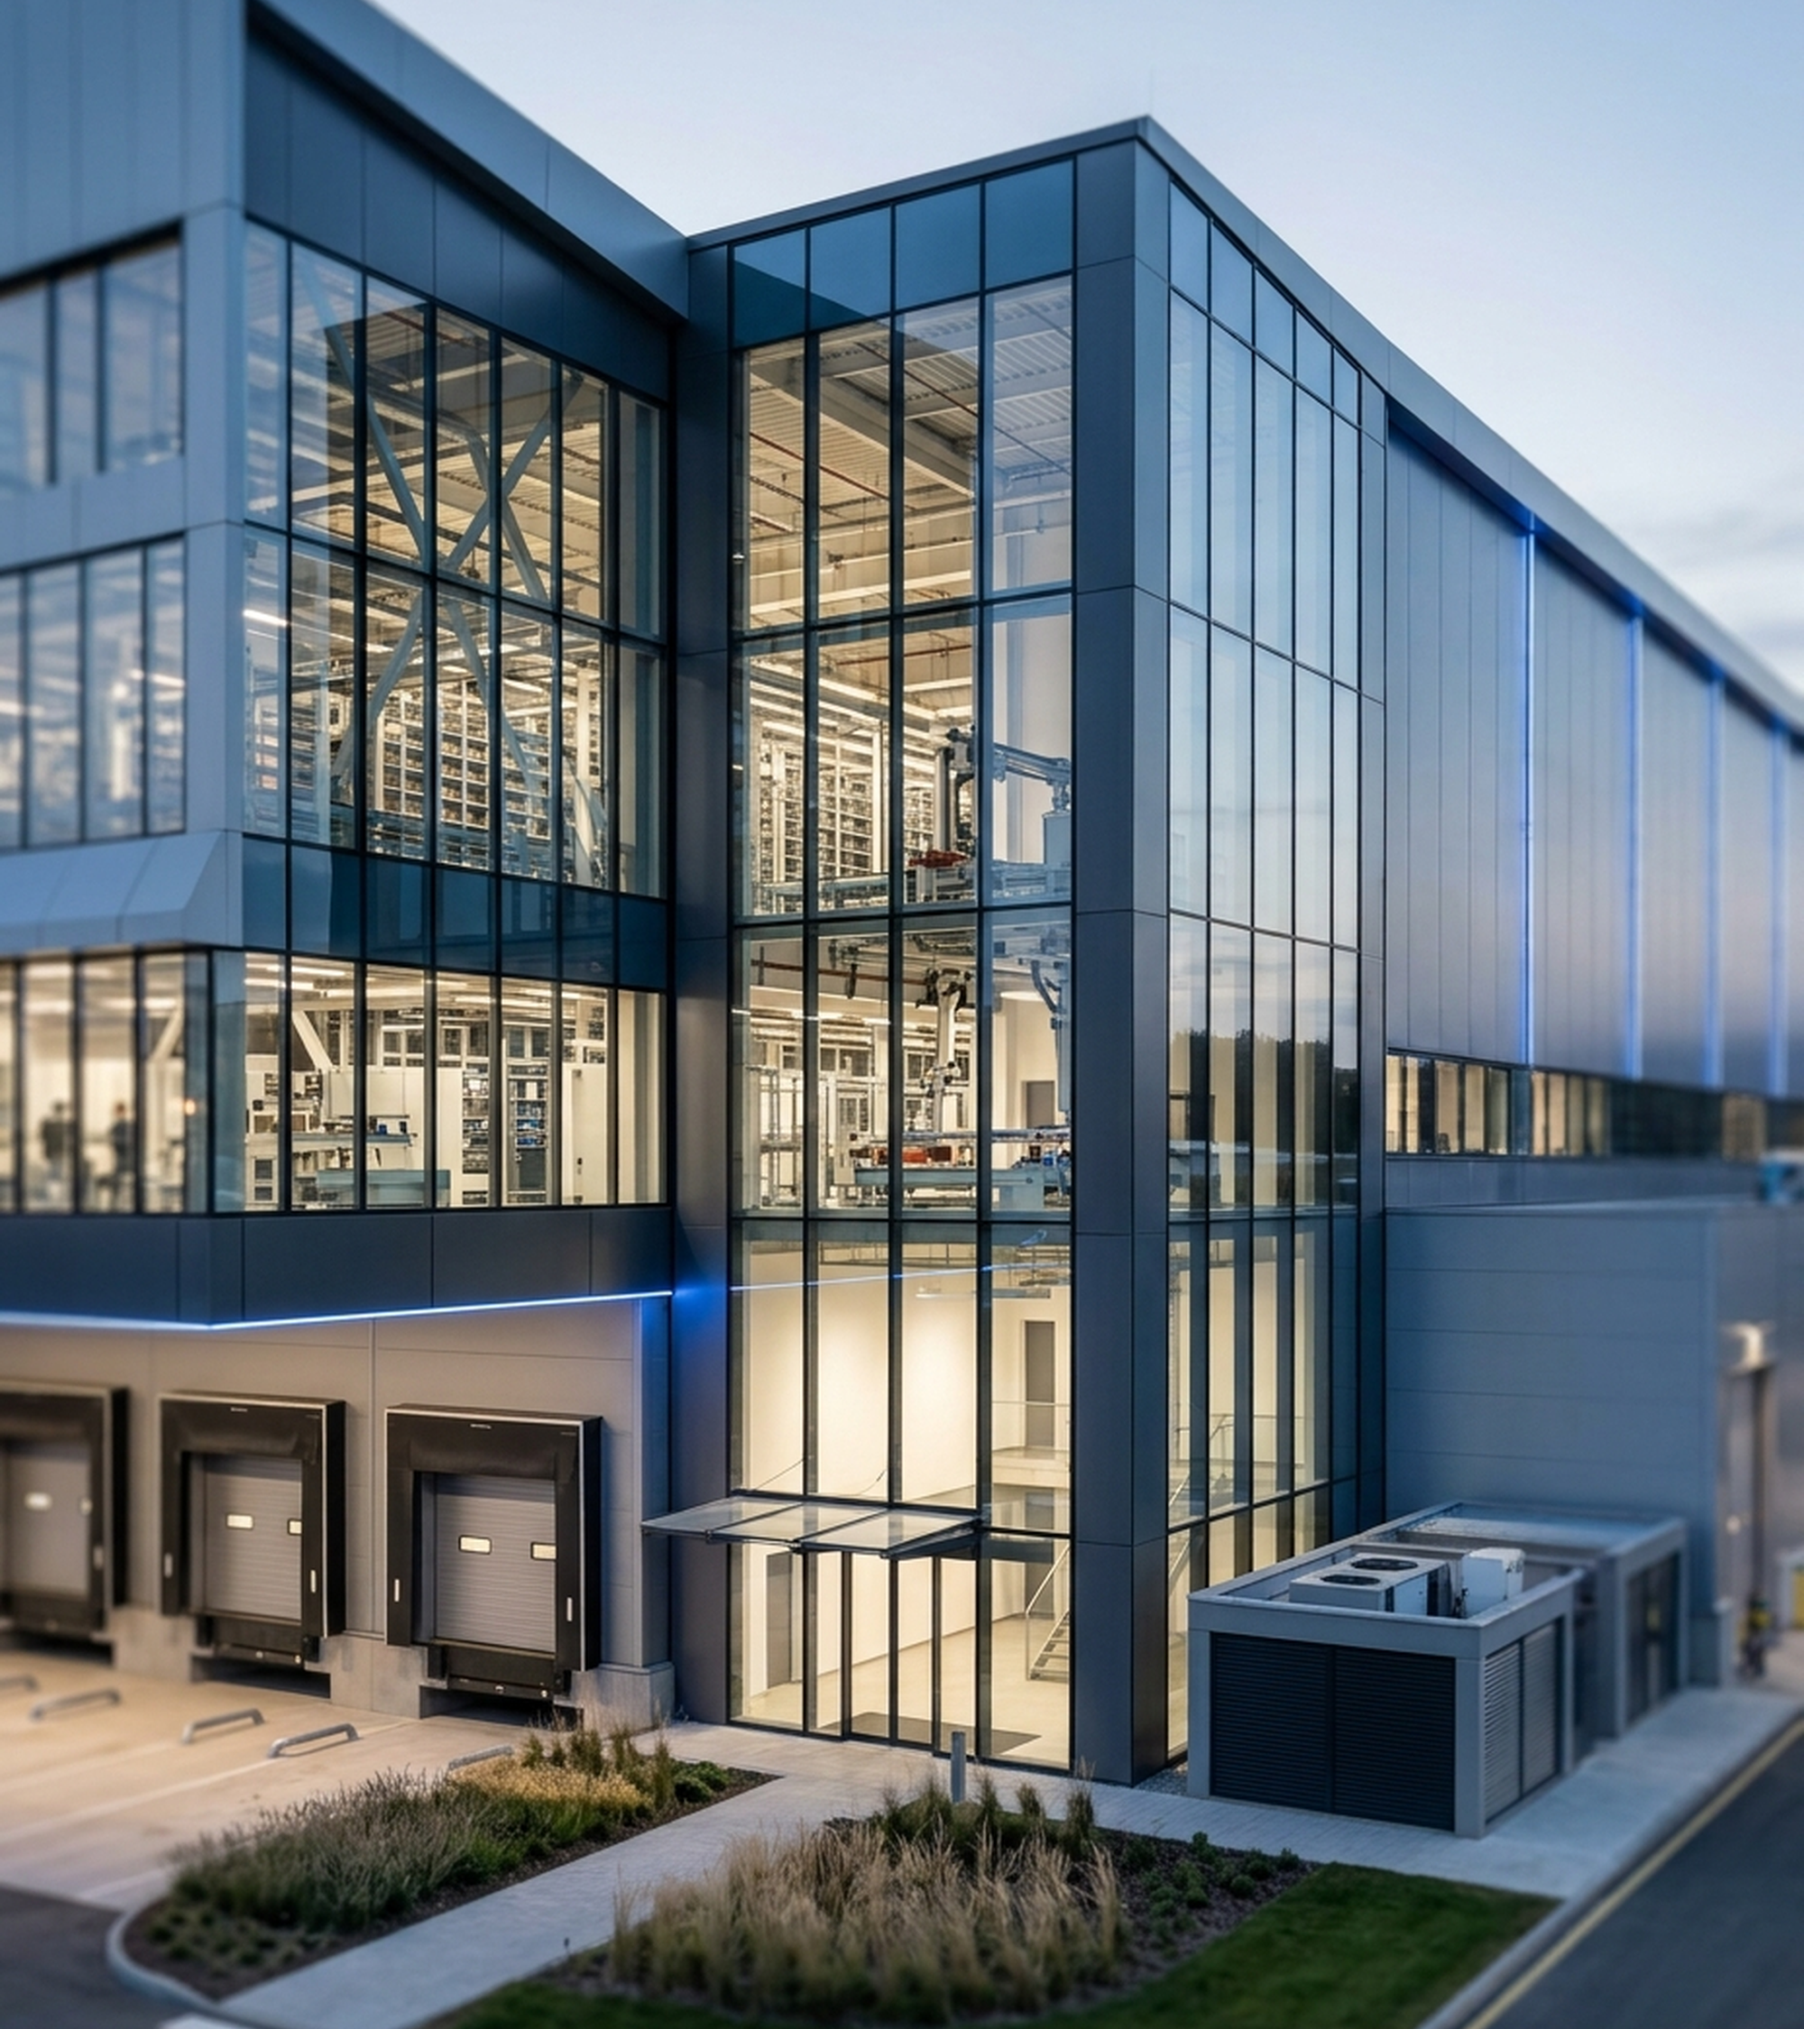
TABLE OF CONTENTS
Five Steps to Autonomous Commerce
01 The Problem: Manual B2B orders, flash-sale overselling, and tied-up capital
02 The Solution: One unified platform powered by AI and real-time stock control
03 Key Capabilities: Closed-loop AI agents and instant multichannel inventory sync
04 Business Impact: 300x faster order entry, zero overselling, and lower costs
05 Conclusion: Strategic takeaway and future vision for autonomous brands

Slide 3
01. THE INDUSTRY PROBLEM
Three Operational Bottlenecks Drain Brand Revenue
Slow B2B Ordering
15-20 Mins: Manual entry from chats and paper invoices
12% Error Rate: Frequent SKU mistakes delay shipments
Flash Overselling
10,000 Req/s: Traffic spikes overwhelm standard stores
Lost Trust: Cancelled orders hurt brand reputation
Blind Inventory
>30 Days Idle: Slow-moving stock locks up cash flow
Sudden Stockouts: Bestsellers run out without early alerts

Slide 4

02. OUR SOLUTION
Unifying AI and Real-Time Stock
Unified Commerce Hub: Connects B2B wholesale and multichannel B2C sales in one place
Autonomous AI Brain: Automates order capture, stock forecasting, and smart clearance
Zero-Overselling Core: Locks inventory instantly during high-traffic flash sales
Multi-Brand Privacy: Keeps every business's commercial data strictly isolated

Slide 5
03. KEY CAPABILITIES — AI AUTOMATION
Three AI Agents Automate Daily Supply Chain Work
Snap-to-Order AI
3-Sec Entry: Turns invoice photos into B2B orders
High Accuracy: Matches item names with >=80% confidence
Smart Restocking
30-Day Velocity: Tracks sales speed to predict stockouts
Auto Draft POs: Prepares purchase orders before stock runs out
Dynamic Markdowns
Slow-Stock Scan: Flags items unsold for over 30 days
Profit Guard: Clears stock with a >=10% margin floor

Slide 6

03. KEY CAPABILITIES — RELIABLE OPERATIONS
Real-Time Sync Prevents Overselling
Instant Checkout Lock: Reserves stock in 10ms so two buyers never claim one item
Auto Stock Recovery: Releases unpaid cart reservations after 15 minutes
Multichannel Sync: Unifies inventory across Shopify, Shopee, Lazada, and TikTok
Zero Double Charges: Blocks duplicate payments caused by slow network clicks

Slide 7
04. BUSINESS IMPACT
Autonomous Operations Deliver 300x Faster Order Processing
3 Sec vs. 15 Min: 300x faster B2B wholesale order entry with AI
0% Overselling: 100% inventory accuracy during peak flash sales
2.4x Capital Turn: Faster inventory turnover through smart clearance
80% Lower Cost: Shared multi-tenant platform cuts infrastructure spend

Slide 8
04. COMPETITIVE ADVANTAGE
OmniTenant Outperforms Legacy ERPs and Standard Stores
Capability | Legacy ERP / WMS | Standard E-Commerce | OmniTenant Platform
B2B Order Entry | Manual typing (15m) | Paid 3rd-party apps | AI Snap-to-Order (3s)
Stock Forecasting | Static min/max rules | Passive stock alerts | Predictive AI & Auto-PO
Slow-Stock Clearance | Monthly spreadsheets | Manual promo codes | 1-Click Margin-Safe Promo
Flash-Sale Traffic | Slow under web spikes | Prone to overselling | Zero-Overselling Lock
Multi-Brand Cost | High per-user license | Per-store monthly fee | 80% Lower Shared Cost

Slide 9
05. CONCLUSION
Autonomous AI Is the Future of Multichannel Commerce.
• Bank-Grade Multi-Tenant Foundation:
21 PostgreSQL RLS policies, RFC 7807 observability, and Two-Phase Redis Redlock ensuring 0% cross-tenant leakage and zero overselling.
• Closed-Loop Tri-Agent Automation:
Unifying Order Intake (Agent 1), Stockout Prevention (Agent 2), and Dead-Stock Liquidation (Agent 3) into a single self-driving workflow.
• Measurable Business Impact:
90% faster B2B order processing, 2.4x faster capital turnover, and a strict >=10% Gross Margin guardrail.
Thank You For Listening

